Slide 1

Web Service

Slide 2
Definition

Slide 3
A Web Service is a software component that is described via WSDL and is capable of being accessed via standard network protocols such as but not limited to SOAP over HTTP.

Slide 4
"Web Services provide a simplified mechanism to connect applications regardless of the technology or devices they use, or their location. They are based on industry standard protocols with universal vendor support that can leverage the internet for low cost communications, as well as other transport mechanisms. The loosely coupled messaging approach supports multiple connectivity and information sharing scenarios via services that are self describing and can be automatically discovered."

Slide 5
Introducation

Slide 6
What are Web Services?
Web services are application components
Web services communicate using open
protocols
Web services are self-contained and self-
describing
Web services can be discovered using UDDI
Web services can be used by other
applications
XML is the basis for Web services

Slide 7
The XML Web services programming model enables you to build highly scalable, loosely coupled, distributed applications using standard Web protocols such as HTTP, XML, and SOAP. XML Web services enable disparate applications to exchange messages using standard protocols such as HTTP, XML, XSD, SOAP, and Web Services Description Language (WSDL).

Slide 8
One of the core characteristics of an XML Web service is the high degree of abstraction that exists between the implementation and the consumption of a service. By using XML-based messaging as the mechanism by which the service is created and accessed, both the XML Web service client and the XML Web service provider are freed from needing any knowledge of each other beyond inputs, outputs, and location.

Slide 9
Creating an XML Web service is similar to creating a Component Object Model (COM) component that provides application logic to a client application.

Slide 10
XML Web services use XML-based messaging to send and receive data.
XML Web services use XML-based messaging as a fundamental means of data communication to help bridge the differences that exist between systems that use incongruent component models, operating systems, and programming languages.

Slide 11
You can use XML Web services to integrate applications that are written in different programming languages and deployed on different platforms.

Slide 12
One important feature of the XML Web services based computing model is that a client need not know the language in which XML Web services are implemented. The client just needs to know the location of an XML Web service and the methods that the client can call on the service.

Slide 13
An XML Web service can consist of specific programming logic to provide functionality.

Slide 14
Client applications can call a method on the service and provide the necessary information as arguments to the method call. The data related to the method call and to the arguments is sent to the Web service in XML format using the SOAP protocol over the HTTP transport.

Slide 15
An XML Web service can be used internally by a single application or exposed externally over the Internet for use by any number of applications.

Slide 16
Web services are broadly supported by all of the relevant players in the computing software field including Microsoft, IBM, Sun, Oracle, HP, etc. This agreement means that an application implemented in C# running on the .Net runtime environment on a Windows machine will be able to communicate natively with services implemented in, say, Java, running on an IBM application server running on a Sun Solaris operating system.

Slide 17
Creating Web Service

Slide 18
To create an XML Web service, you first choose a programming language in which you want to create the service and create a class that inherits from
System.Web.Services.WebService.

Slide 19
Steps to Create a Web Service

Slide 20
Step 1.
Open the Visual Studio .NET IDE. Start a project to create an application or a service by pointing to New on the File menu and choosing Project to open the New Project dialog box.

Slide 21
Step 2.
In the New Project dialog box, select Visual Basic Projects in the Project Types pane. In the Templates pane, select ASP.NET Web Service. In the Location box, type the name and location of the XML Web service as http://localhost/TravelService, and click OK. Figure shows the New Project dialog box.

Slide 22
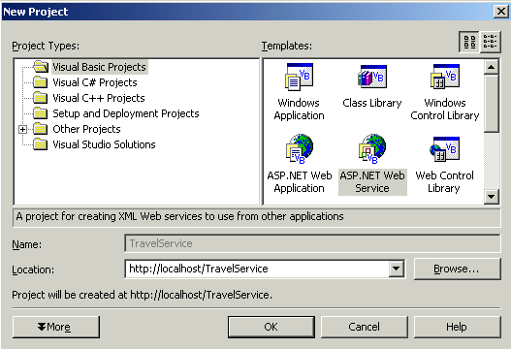

Slide 23
Step 3.
The Create New Web message box appears while a Web folder with the specified name is being created. Figure shows the Create New Web message box.

Slide 24
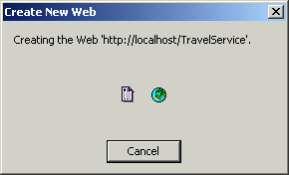

Slide 25
Step 4.
When you create the ASP.NET Web service project, the default page is displayed in design mode, and an .asmx file is created. After creating an XML Web service project, you write the code to provide functionality to the XML Web service. This code is stored in a file associated with the .asmx.cs or .asmx.vb file and is known as the code-behind file. The code-behind file depends on the language that you use to create the XML Web service. For a Visual C# project, the code-behind file is a .cs file. For a Visual Basic .NET project, the code-behind file is a .vb file.

Slide 26
Step 5.
Rename the Service1.asmx file in the Solution Explorer as TravelService.asmx.

Slide 27
Step 6.
To add functionality to the XML Web service, select the Solution Explorer tab, right-click the TravelService.asmx file, and choose View Code. The window in which you write the code for the service appears. Figure shows the startup screen of the TravelService XML Web service.

Slide 28
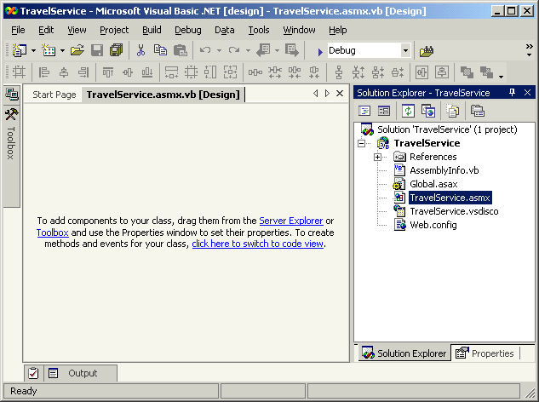

Slide 29
For each XML Web service that you create, the following files are created by Visual Studio .NET:
AssemblyInfo.cs or AssemblyInfo.vb
Global.asax
Global.asax.cs or Global.asax.vb
Service1.asmx
Service1.asmx.cs or Service1.asmx.vb
Service1.vsdisco
Web.config

Slide 30
AssemblyInfo File
An assembly is the functional unit for sharing and reuse in the common language runtime. The AssemblyInfo file consists of general information about the assemblies in the project. To modify the assembly information, such as the version number, you change the attributes in the AssemblyInfo file.

Slide 31
Web.config File
This file contains configuration information, such as the debug mode and the authentication mode for a Web project. It also includes information about whether to display custom errors for a Web project. You can also use the Web.config file to store custom configuration information for your XML Web service.

Slide 32
Global.asax and Global.asax.cs or Global.asax.vb Files
These files enable you to manage application-level and session-level events. These files reside in the root directory of an ASP.NET Web application or ASP.NET Web service. The Global.asax.cs or Global.asax.vb class file is a hidden, dependent file of Global.asax, which contains the code for handling application events such as the Application_OnError event.

Slide 33
Service1.asmx and the Service1.asmx.cs or Service1.asmx.vb Files
These two files make up a single XML Web service. The Service1.asmx file contains the XML Web service processing directive and serves as the addressable entry point for the XML Web service. The Service1.asmx.cs or Service1.asmx.vb class file is a hidden, dependent file of WebService.asmx and contains the code-behind class for the XML Web service.

Slide 34
WebService.vsdisco
The .vsdisco file is also known as the discovery file. This file is an XML-based file that contains links or URLs to resources providing discovery information for an XML Web service.

Slide 35
How to use a Web Service

Slide 36
To enable client applications to access and use the XML Web service, you expose the functionality of the XML Web service by creating Web methods.

Slide 37
Web methods are independent functional units that perform certain predefined operations in an XML Web service. You use the <WebMethod> attribute in Visual Basic .NET or the [WebMethod] attribute in Visual C# to declare a Web method, depending on the language you choose to develop your XML Web service.

Slide 38
Visual Basic .NET
<WebMethod()>
Public Function HelloWorld() As String
HelloWorld = "Hello World“
End Function
Visual C#
[WebMethod]
public string HelloWorld()
{
return "Hello World";
}

Slide 39
Attributes of a Web Method

Slide 40
You supply the WebMethod attribute to any method that you want to expose as a method of an XML Web service. The WebMethod attribute enables a client application to use standard Internet protocols to access the method.

Slide 41
The WebMethod attribute provides the following properties that enable you to customize and control the behavior of the methods that you expose in your Web service:
BufferResponse
CacheDuration
EnableSession
MessageName
TransactionOption

Slide 42
Buffering Responses for a Web Method
You buffer responses for a Web method to improve the performance of an application by reducing communication between the worker process and the IIS process. To buffer responses for a Web method, you use the BufferResponse property of the WebMethod attribute. When you set the BufferResponse property to True, ASP.NET buffers all the responses before communicating them to the client. If you set the BufferResponse property to False, ASP.NET buffers the responses in chunks of 16 KB each. The default value of the BufferResponse property is True. The following Microsoft Visual Basic .NET and Microsoft Visual C# code samples show how to use the BufferResponse property.

Slide 43
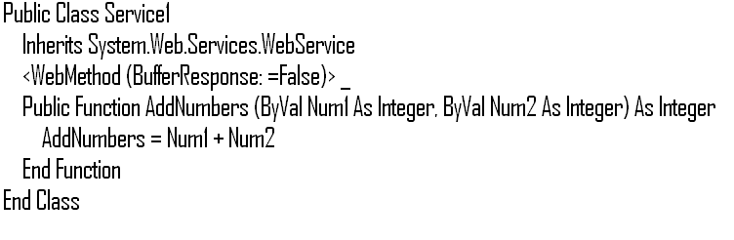

Slide 44
Caching the Results for a Web Method
The CacheDuration property of the WebMethod attribute enables you to cache the results for a Web method. ASP.NET caches the results for each unique parameter set for the duration that you specify as the value of this property. The default value of the CacheDuration property is zero. The following code sets the CacheDuration property of the AddNumbers Web method to 60 seconds.

Slide 45
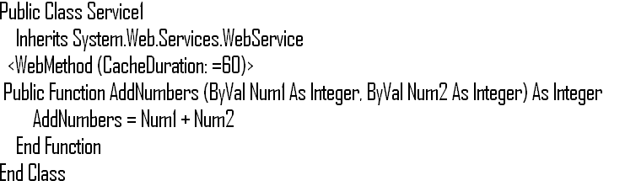

Slide 46
Specifying a Description for a Web Method
The Description property enables you to specify a description for a Web method. The description that you specify using the Description property appears on the Service help page. The Description property takes a string as an input value. The following code displays how to use the Description property.

Slide 47
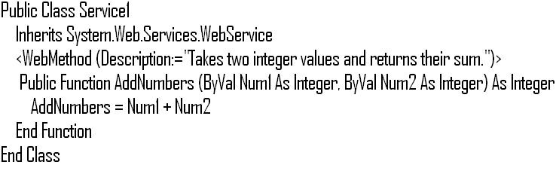

Slide 48
Enabling a Session State for a Web Method
You can configure a Web method to maintain the state of objects across sessions. The EnableSession property of the WebMethod attribute allows you to enable the session state for a Web method. If you set the EnableSession property to True, the XML Web service accesses the session state collection directly from the HttpContext.Current.Session session or the WebService.Session property if it is inherited from the WebService base class. The default value of the EnableSession property is False. The following code displays how to enable the session state for a Web method

Slide 49
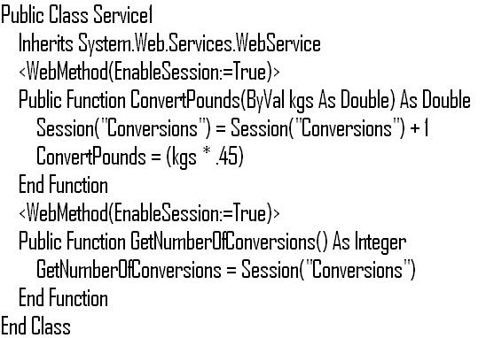

Slide 50
Identifying Overloaded Web Methods Using an Alias
You can use the MessageName property of the WebMethod attribute to uniquely identify overloaded Web methods. The MessageName property enables you to use an alias to uniquely identify Web methods in an XML Web service. When you specify a value for the MessageName property, the SOAP messages use this value as the method name instead of the actual method name. The following code sample displays how to use the MessageName property.

Slide 51
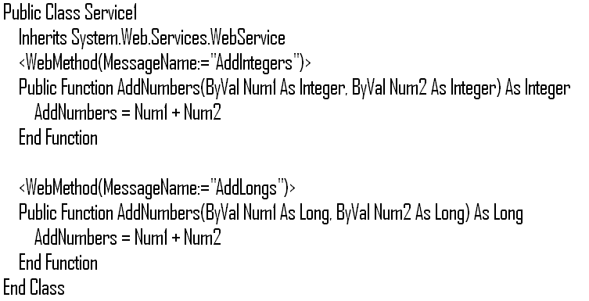

Slide 52
Enabling a Web Method to Participate as the Root Object of a Transaction
You can use a Web method to support transactions and enable a Web method to participate as the root object of a transaction. You can use this property to specify whether you want the Web method to participate in a transaction or not. The TransactionOption property can take the following values: Disabled, NotSupported, Supported, Required, and RequiresNew. To support transactions and enable a Web method to participate as the root object of a transaction, you can set TransactionOption to Required or RequiresNew. On the other hand, to disable transaction support for a Web method, you can set TransactionOption to Disabled, NotSupported, or Supported.

Slide 53
Steps

Slide 54
Step 1.
The client creates an object of the XML Web service proxy class on the same computer on which the client resides.

Slide 55
Step 2.
The client calls a method on the proxy object.

Slide 56
Step 3.
The XML Web services infrastructure on the client system serializes the method call and arguments into a SOAP message and sends it to the XML Web service over the network.

Slide 57
Step 4.
The infrastructure on the server on which the XML Web service resides deserializes the SOAP message and creates an instance of the XML Web service. The infrastructure then calls the method with the arguments on the XML Web service.

Slide 58
Step 5.
The XML Web service executes the method and returns the value with any out parameters to the infrastructure.

Slide 59
Step 6.
The infrastructure serializes the return value and any out parameters into a SOAP message and sends them to the client over the network.

Slide 60
Step 7
The infrastructure on the client computer deserializes the SOAP message containing the return value and any out parameters and sends them to the proxy object.

Slide 61
Step 8.
The proxy object sends the return value and any out parameters to the client.

Slide 62
Deploy Web Service

Slide 63
You can deploy an XML Web service on a Web server in two ways. You can either create a Web setup project or copy the XML Web service files to the Web server.

Slide 64
Security in Web Service

Slide 65
The configuration files are XML-based files, which you can use to change the settings of your applications without recompiling them.

Slide 66
The Web.config file enables you to define configuration settings when your Web service is deployed. The features of the Web.config file include the uses following:

Slide 67
1.
Multiple configuration files can exist in various Web application folders on a Web server. Each Web.config file applies configuration settings to its own Web application folder and to all the child folders. The Web.config files in the child folders can contain configuration information that is in addition to the configuration information inherited from the parent folder.

Slide 68
2.
At run time, the common language runtime the configuration information in the Web.config files in a hierarchical structure to create a collection of configuration settings for each unique URL. The resulting configuration settings are then cached for all subsequent requests made to a resource.

Slide 69
3.
The common language runtime can automatically detect changes made to Web.config files and apply the new settings to a Web service. In addition, hierarchical configuration settings are automatically recalculated and cached again when you make modifications to a Web.config file in the hierarchy.

Slide 70
4.
The Web.config file is extensible. Therefore, you can define new configuration parameters and write configuration section handlers to process them.

Slide 71
5.
The Web server prevents direct access to the Web.config file. The Web server returns the HTTP access error 403 to any browser that tries to request a configuration file directly.

Slide 72
Using the Elements of the Web.config File to Configure a Web Service

Slide 73
All the attributes of the configuration settings are present within the <configuration> and </configuration> root tags.

Slide 74
<compilation />
You use this tag to specify the compilation language and whether you want to debug the Web service. You can set the debug attribute to True to insert debugging symbols (.pdb information) into the compiled page. For example, the <compilation defaultLanguage="vb" debug="true" /> tag sets the default language to VB and enables debugging of the XML Web Service.

Slide 75
<customErrors />
You use this tag to manage custom error messages. You can set the mode attribute to On or RemoteOnly to enable custom error messages, and Off to disable error messages, as in the tag <customErrors mode="RemoteOnly" />.

Slide 76
<authentication />
You use this tag to specify the authentication policies of the application. You can set the mode attribute to Windows, Forms, Passport, or None. The Web service uses the authentication policy that you specified to authenticate users, as in the tag <authentication mode="Windows" />.

Slide 77
<authorization />
You use this tag to set the authorization policies of your Web service. You can allow or deny access to your Web service. You can set the users attribute to * and ? wildcards to allow everyone and anonymous or unauthenticated users, respectively, as in the tag <allow users="*" />.

Slide 78
<trace />
You use this tag to enable application-level tracing of the Web service. This enables trace log output for every page within an application. You can set the enabled attribute to True to enable application trace logging, as in the tag <trace enabled="false" />.

Slide 79
Securing Web Service
using Authentication

Slide 80
You can specify the following authentication providers in your Web service:
Windows
Forms
Passport
None

Slide 81
Windows
This is the default authentication mode. When you specify the authentication mode as Windows, the authentication process relies upon IIS to perform the required authentication of a client. After IIS authenticates a client, IIS passes a security token to the Web service. The following code shows how to use Windows authentication:
<authentication mode="Windows" />

Slide 82
Forms
You can use this authentication mode to ensure that a Web service collects credentials using an HTML log-in form directly from the client. The client submits credentials to your Web service for authentication. When the Web service authenticates the client, it issues a cookie to the client. The client uses this cookie to access the Web service. If a request for a protected service does not contain the cookie, the client is redirected to the HTML log-in page specified in the configuration file. The following code displays how to use Forms authentication:
<authentication mode="Forms">
<forms forms="Sales" loginUrl="/login.aspx" /></authentication>

Slide 83
Passport
This authentication provider is a centralized authentication service. The Passport authentication mode enables a single logon and profile services for member sites. Passport is a forms-based authentication service in which member sites register with the Passport service. The Passport service grants a site-specific key. The Passport logon server uses this key to encrypt and decrypt the query strings that are passed between the member site and the Passport logon server. The following code displays how to use Passport authentication:
<authentication mode="Passport" />

Slide 84
None
You use this authentication provider if you do not want to authenticate users or if you want to use custom authentication code. The following code displays how to use None:
<authentication mode="None" />

Slide 85
Securing Web Service
using Authorization

Slide 86
You can use the <authorization /> tag to specify the users and roles that can access your Web service. This tag enables you to implement both positive and negative authorization assertions. You use this tag to allow or deny access to your Web service based on specific users or roles.

Slide 87
To specify roles and users who can access your Web service, you place a list of users and roles in the <allow> or <deny> elements of the <authorization> tags in the Web.config file. The following code displays how to allow and deny permissions to specific users and roles:
<authorization>
<deny users=“Ravi"/>
<allow role="Administrator" />
</authorization>

Slide 88
In addition to specific roles and users, you can use the * and ? wildcards to allow or deny permission to all and anonymous identities, respectively. The following code displays how to deny access to all users except one:
<authorization>
<allow users=“Ravi" />
<deny users="*" />
</authorization>

